Slide 1
SPAM DETECTION USING MACHINE LEARNING…
BY JIDNYASA KAMBLE

Slide 2
Why spam detection ?
Spam emails are messages randomly sent to multiple users by sorts of groups, but mostly lazy advertisers and criminals who to lead you to the phishing sites.
Once spam hits your email inbox, you become a target. When it comes to technology, humans tend to be the weakest link in most IT security situations
Attackers will constantly try to trick them, manipulate users to click on things that they shouldn't through a variety of methods. Oftentimes, these "tricks" are via emails and sms, as email platforms can target a very large number of people
If users happen to click the wrong thing within the spam email or sms, internal data then becomes exposed.
Since email is commonly used as a way to exploit users and their data, spam filtering has grown in importance and relevance. Organizations must utilize a spam filter to reduce the risk of users clicking on something they shouldn't, in turn keeping their internal data shielded from a cyber attack.
Spam filtering is essentially an anti-malware tool, as many attacks through email are trying to trick users to click on a malicious attachment, asking them to supply their credentials, or asking for payments and much more.

Slide 3
Objective
The main objectives of identification of Spam e-mails are:
To give knowledge to the user about the fake and relevant emails.
To save users from clicking harmful links.
Also important mails or messages are missed and spam emails occupy storage this things can be reduced.

Slide 4
Data Description…
Dataset used here contains two columns named originally text and target.In target we have two category ham and spam.
Spam are the unrequired emails or messages.
Ham means normal emails or messages.
The classes are mapped to binary integer 0 for ham and 1 for spam by using LabelEncoder from sklearn.preprocessing .

Slide 5
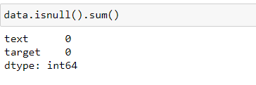
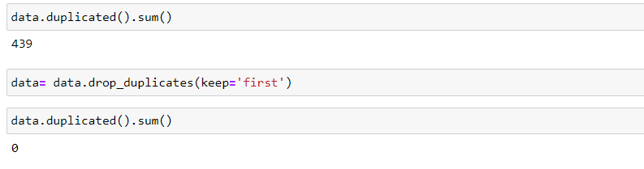
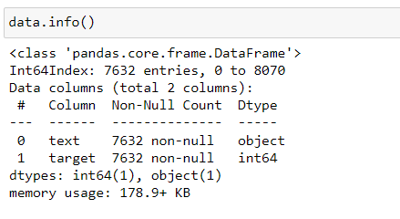
Basic data cleaning process in data…
Check any null values are present in the data:
Check any duplicate value is present if any than drop them off:
Check the info of the data:

Slide 6
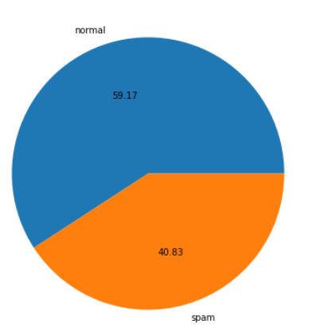
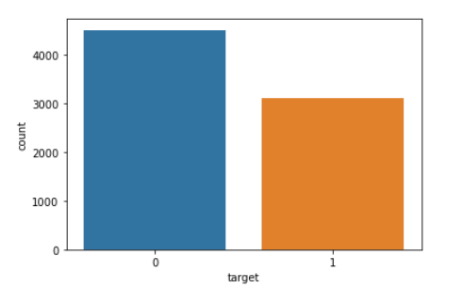
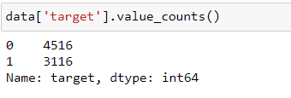
INSIGHTS OF DATA:

Slide 7
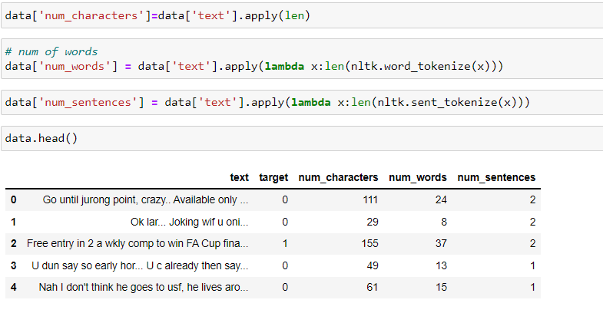
Analysis of sentences…

Slide 8
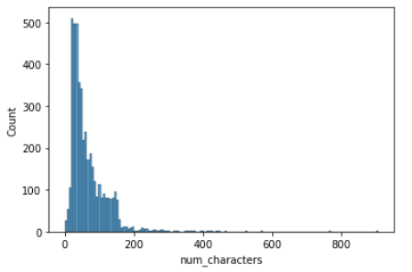
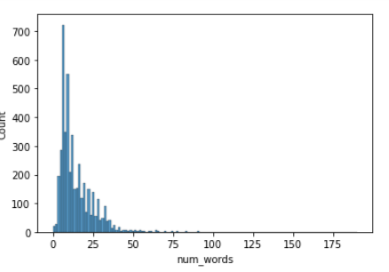
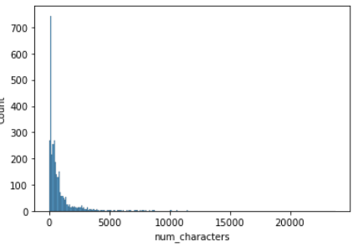
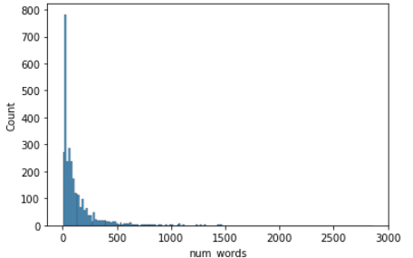
Numbers of character in normal messages
Numbers of words in normal messages
Numbers of character in Spam messages
Numbers of words in Spam messages

Slide 9
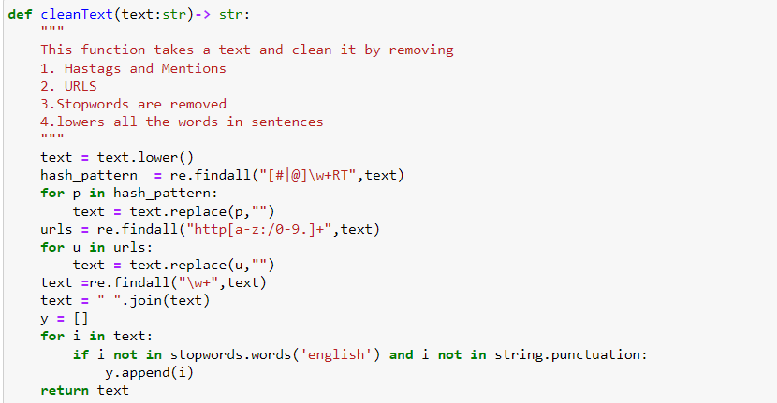
Data cleaning..
Lowercase all the words present in a sentence.
Remove all urls and hastags
Stopwords removing removes stopwords present in the sentences
Stopwords like:-I,me,myself,we,our,ourselfes,etc.

Slide 10
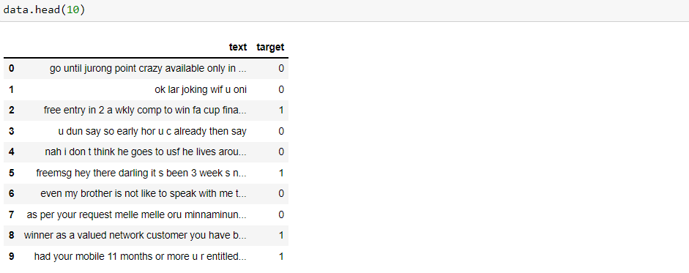
Clean and useable data for ML MODELS:

Slide 11
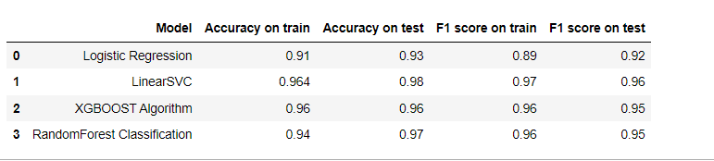
Machine learning models results:

Slide 12
THANK YOU

